Slide 1
The Clapper version 2.0
By Jeroen Goossens and Cristopher Bello
Written in the only real clap language, node.js

Slide 2
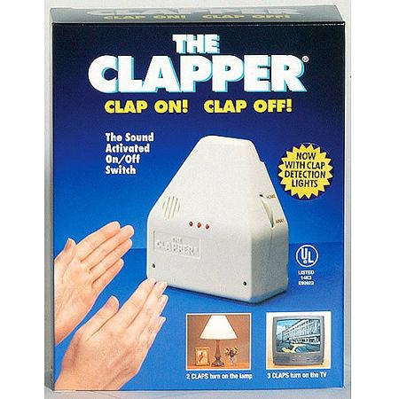
Back in ye olden days…
Max 2 lights
Big (2.5 x 6.25 x 8.0) inches [L x W x H]
Expensive (20$ at Wall-Mart)
Impossible to configure
Made for grannies, supported by fanatics

Slide 3
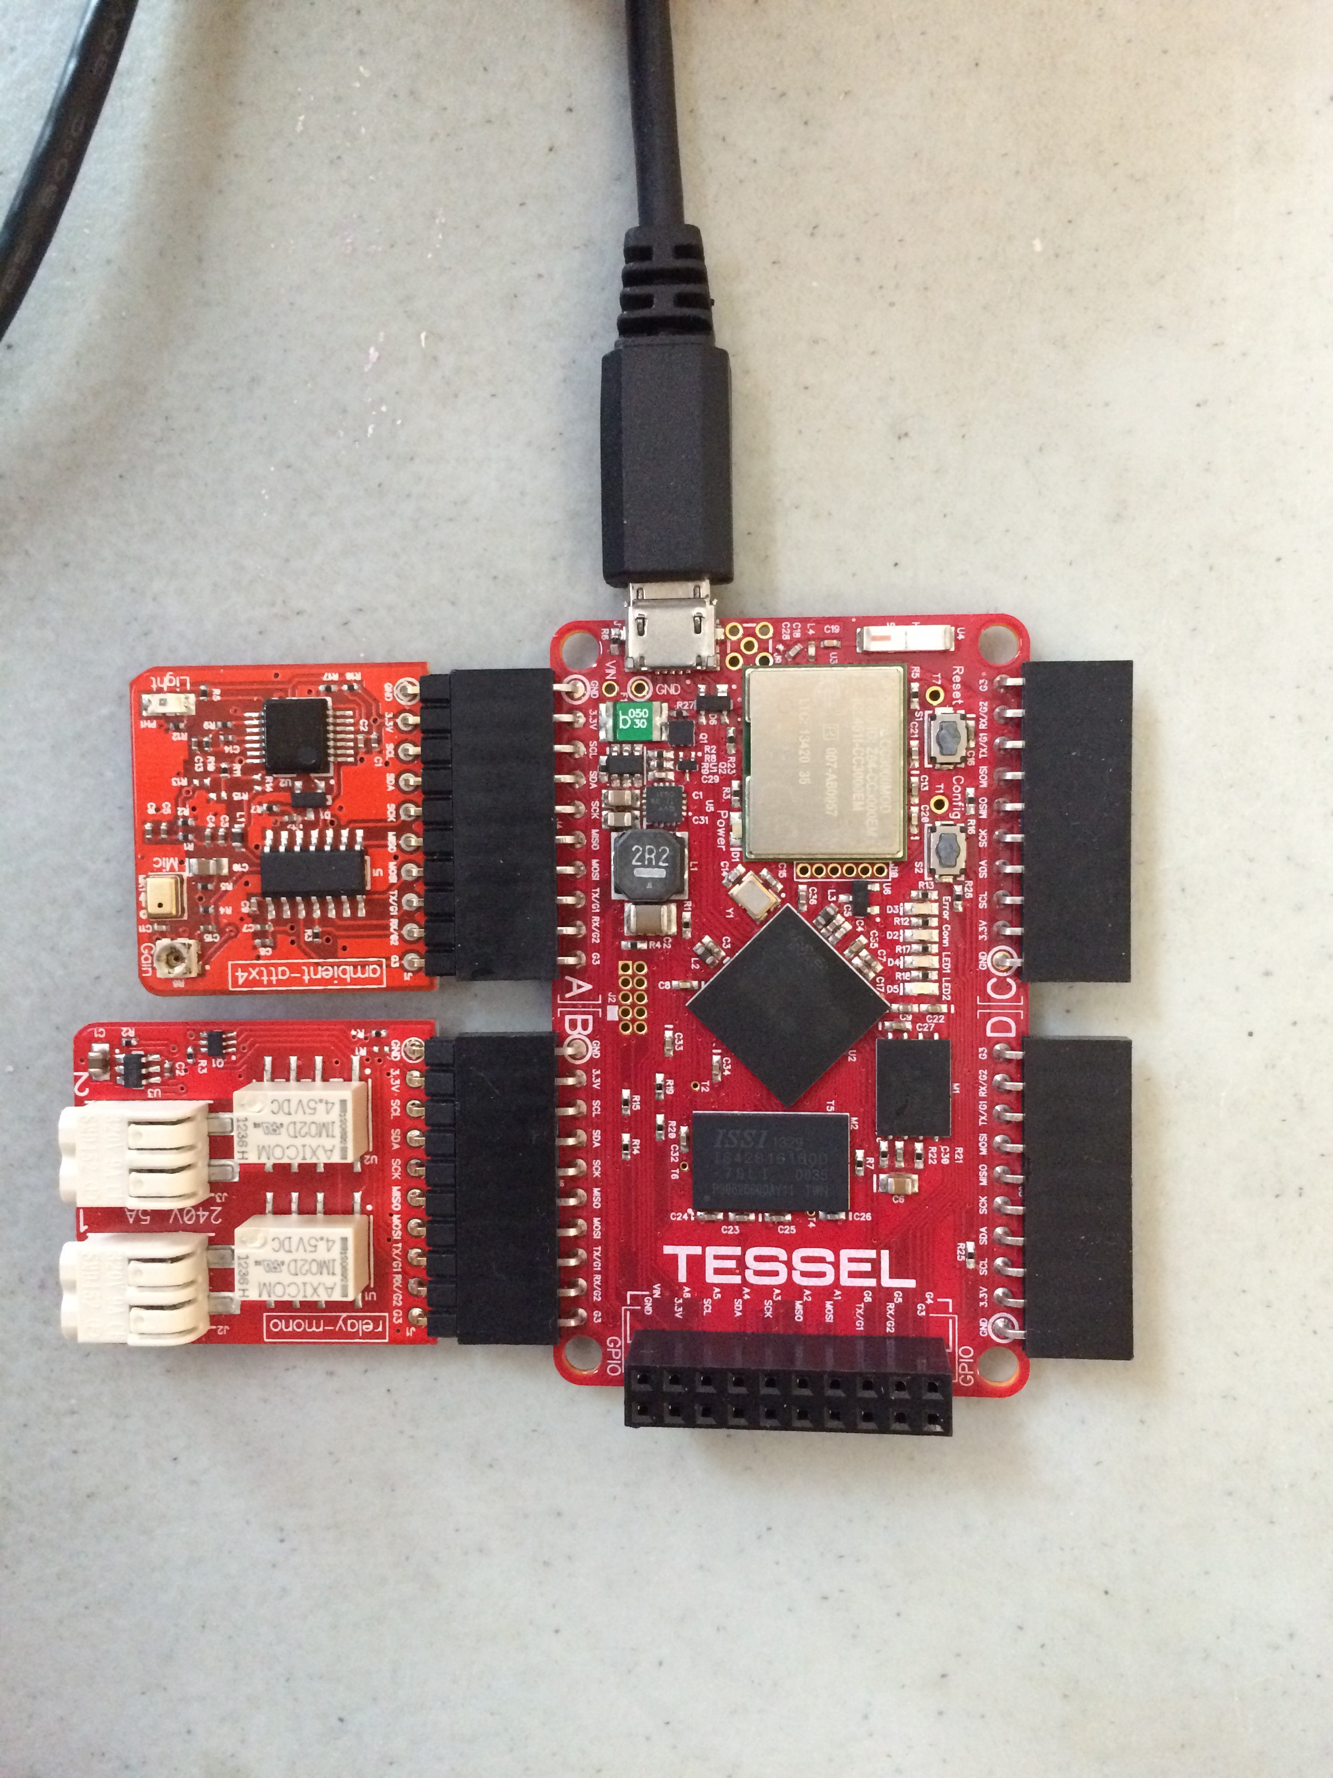
NO MORE!!!!
Our version:
Smaller
More customizable, with infinite clap combinations
Train it to listen to specific rhythms
Up to 6 relay ports
Easy to use/maintain
Node.js!!!!!
Cheaper upon mass production
Ambient noise module
↓
Tessel board
↓
Relays

